Slide 1


Cheshire East
Safeguarding Children’s Partnership
Yearly Report 2025/2026

Slide 2
Contents
Forward by the Chair
Statutory Requirements and Expectations
Strategic Aims
Shared Vision
Key Values
Ofsted Inspection of Local Authority Children Services
Governance
Cheshire East Local Profile
Local Data
Performance and Quality Assurance Framework
Multiagency Audits
Education
Section 175 Audit
Hearing the Voice of the Child and Their Lived Experience
Voice of Children, Young People and Families Impact and Outcomes
Progress Against Priorities
Child Safeguarding Practice Reviews
Child Safeguarding Practice Review Outcomes and Impacts
Child Safeguarding Practice Review Group
Child Death Overview Panel
Workforce Development
Training Feedback
Practice Observations
Partnership Development Session
Priorities for the Year Ahead
Scrutiny
Families First : An Integrated System
Key Decision Making and Partnership Funding
Changes to the MASA 2024

Slide 3


Foreword by the Chair
I am pleased to introduce the Cheshire East Safeguarding Children’s Partnership (CESCP) Annual Report for 2025/26. This report provides an overview of the Partnership’s work during the year, assesses the effectiveness of our multi-agency safeguarding arrangements, and highlights the impact of collective efforts to improve outcomes for children, young people and families.
I would like to thank all partners and practitioners for their continued commitment to safeguarding children across Cheshire East. Through strong collaboration, shared accountability and a focus on children most at risk of harm, partners have continued to strengthen safeguarding practice and improve support for children and families.
Since joining the Partnership in 2024 and becoming Chair in June 2024, I have seen considerable progress despite a period of significant change, including revised governance arrangements, changes in Delegated Safeguarding Partners, and ongoing improvement activity across agencies. Throughout this period, partners have remained committed to effective oversight and collective responsibility for safeguarding children.
During 2025/26, the Partnership further strengthened its Multi-Agency Safeguarding Arrangements, which came into effect in April 2026, providing clearer leadership, enhanced assurance and a stronger focus on learning, impact and continuous improvement.
The Partnership maintained its strategic focus on Harm Outside the Home, Child Sexual Abuse and Child Neglect. In recognition of the progress achieved, Education as a Protective Factor was successfully embedded into business-as-usual arrangements and is now overseen through routine governance and assurance processes.

Slide 4
Learning and improvement remain central to our work. During the year, the Partnership undertook four Rapid Reviews and commissioned one Local Child Safeguarding Practice Review.
A dedicated Child Safeguarding Practice Review Group was established to ensure learning is effectively disseminated, embedded and translated into practice improvement. This work has been strengthened through participation in the North-West Regional Improvement Pilot, supporting collaboration, peer challenge and sector-led improvement.
The Partnership has continued to prepare for national reform, including implementation of Working Together 2026 and the wider Families First agenda. This work reflects our commitment to strengthening multi-agency accountability, promoting earlier intervention and demonstrating the impact of safeguarding activity on children's lives.
Independent scrutiny continues to provide valuable challenge and assurance, supporting the Partnership to evaluate its effectiveness and identify opportunities for further improvement.
As I conclude my role as Chair, I am confident that Cheshire East Safeguarding Children’s Partnership is well placed to build on the progress made and respond to future challenges. I will hand over Chair responsibilities to Temporary Detective Chief Superintendent Claire Jesson, Head of PVP & Safeguarding, Cheshire Constabulary, and I would like to thank all partners for their support and commitment during my tenure. I wish Claire every success as she leads the Partnership into its next phase of development.
Josette Niyokindi
Interim Associate Director of Quality and Safety Improvement

Slide 5
Statutory Requirements and Expectations
The safeguarding partners must publish an annual report which provides transparency and accountability regarding the effectiveness of local safeguarding arrangements. The report should demonstrate how safeguarding partners have worked together, what difference this has made, and how learning has led to service improvement.
Key Expectations Under Working Together 2026
Evidence the Effectiveness of Safeguarding Arrangements The report explains how the safeguarding arrangements are working, and how partners have fulfilled their responsibilities. The report will outline the governance arrangements, and the scrutiny and assurance activity during the period in response to local need.
Demonstrate Impact on Children and Families The report will look at what has changed and what outcomes have improved for children and families.
Partnership Priorities The report includes an update on the partnerships safeguarding priorities, activities undertaken and evidence of progress and impact. Consideration is also given to emerging risks and priorities in response to local need.
Learning, Improvement and Reviews The report demonstrates learning from serious incidents and from local inspections. The report will evidence how learning has resulted in improvements.
Quality Assurance and Performance The report explains audit activity undertaken during the period, themes identified, strengths and areas for improvement. Actions taken in response to finding, emphasises the use of evidence in understanding the effectiveness of local arrangements.
Voice of Children, Young People and Families The report outlines how children, young people and families have been engaged, what they have shared and how this feedback has informed improvement activity.
Education Involvement There is an expectation that safeguarding arrangements demonstrate meaningful engagement with education. The yearly report will look at how education has contributed to the safeguarding arrangements, at a strategic and operational level. The impact this has had on local arrangements and decision making.
Disproportionality, Equality and Inclusion The report demonstrate how the partnership understands and responds to these issues within its local population.

Slide 6
Statutory Requirements and Expectations
Independent Scrutiny The report reflects how independent scrutiny has been used to provide assurance regarding the effectiveness of the arrangement s. The report will illustrate what scrutiny has been undertaken and how the partnership has used this information to identify areas of improvement and good practice.
Funding Arrangements The yearly report includes a breakdown on expenditure, how resources have supported delivery of the safeguarding arrangements, and due consideration of value for money.
Our journey
During 2025/26, the Cheshire East Safeguarding Children’s Partnership continued to discharge its statutory responsibilities by providing effective leadership, challenge, scrutiny and assurance across the safeguarding system.
The Partnership strengthened its Multi-Agency Safeguarding Arrangements, maintained clear governance and accountability structures, and continued to promote strong collaboration between safeguarding partners, relevant agencies and education settings.
Through regular oversight of performance, multi-agency audit activity, safeguarding reviews, independent scrutiny and lived experience feedback, the Partnership has sought to ensure that safeguarding arrangements remain effective, responsive to local need and focused on improving outcomes for children and families.
Throughout the year, the Partnership has demonstrated a strong commitment to continuous learning and improvement. Learning from Rapid Reviews, Local Child Safeguarding Practice Reviews, audits, inspections and practitioner feedback has informed strategic priorities and service development, with a focus on Harm Outside the Home, Child Sexual Abuse and Child Neglect.
The Partnership has also continued to strengthen the voice of children, young people and families within its assurance and improvement activity, whilst preparing for the implementation of Working Together 2026 and the wider Families First reforms.

Slide 7

Strategic Aims
The Cheshire East Safeguarding Children’s Partnership arrangements intend to support and enable local organisations and agencies to work together in a system where:
The Partnership has a wide membership of partners and ‘relevant agencies’, including schools, the faith and voluntary sector, probation services, public health, health providers, the police and representatives from the Local Authority. These executive members work together to keep children and young people safe from harm. The partnership is responsible for scrutinising the work of its partners to ensure that services provided to children and young people make a positive difference.
Partner organisations and agencies collaborate, share and co-own the vision for how to achieve improved outcomes for vulnerable children.
Organisations and agencies challenge appropriately and hold one another to account effectively.
There is early identification and analysis of new safeguarding issues and emerging threats.
Learning is promoted and embedded in a way that local services for children and families can become more reflective and implement changes to practice.
Information is shared effectively to facilitate accurate and timely decision making for children and families
Children are safeguarded and their welfare promoted.

Slide 8
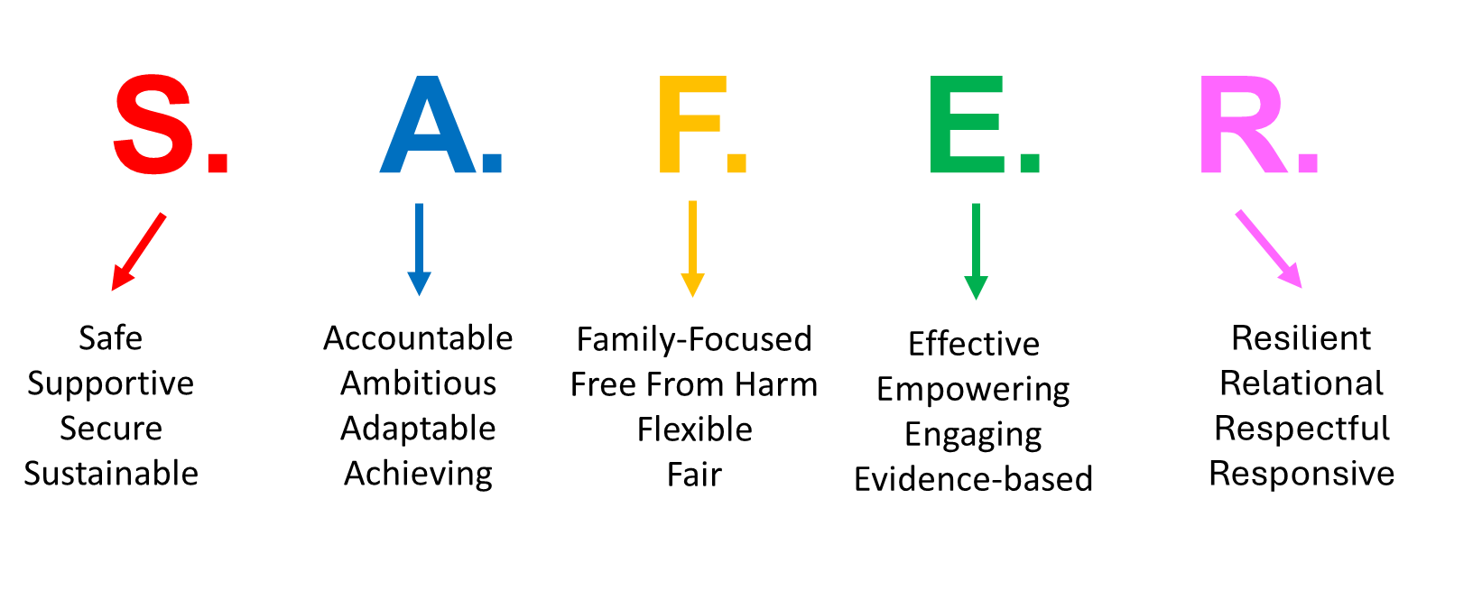
Shared vision and values to improve partnership working
In line with the revised governance arrangements, this is our partnership vision. Our vision is firmly child centred, recognising that effective safeguarding depends on a strong, two-way relationship between frontline practitioners and strategic leaders. Practitioners are supported to understand and deliver the strategic plan in ways that improve outcomes for children, while their experiences and insights shape the partnership’s priorities. These arrangements place children at the heart of our work, ensuring effective communication, stronger collaboration, and the safeguarding of every child.
We remain ambitious that our partnership will enable us to work TOGETHER to make children, families and communities S.A.F.E.R.

Slide 9

Key values
All the work within the Partnership will continue to uphold the following core values:
Listening to and acting on the voice of the child to place them at the heart of the partnership
Embedding the new arrangements to ensure strategic oversight and line of sight to frontline practice
Improving quality assurance and routine, robust performance scrutiny and challenge
Creating a learning culture that takes action to improve practice
Ensuring there is transparent, decisive and evidence-based decision making in all partnership meetings to support improved outcomes
Create a highly effective partnership with communication based on positive relationships, shared values and clear vision

Slide 10
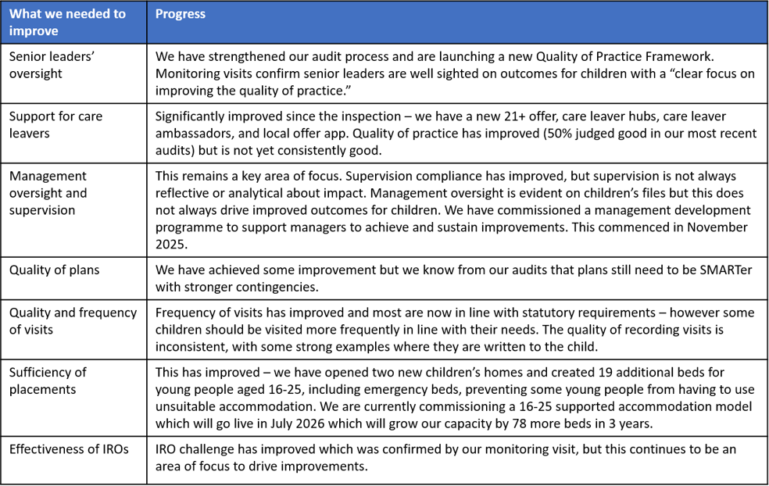
Ofsted Inspection of Local
Authority Children’s Services
We have continued to deliver our improvement plan to address the findings from the Ofsted inspection of children’s services in March 2024. Significant progress continues to be made with 63% actions complete and a further 22% complete and being embedded.
Since April 2025, we have had two Ofsted monitoring visits, along with support from our sector led improvement partner. This external review of our services has confirmed that we are continuing to make progress, with improvements in specific areas of practice, and that staff at all levels are committed to making improvements.
Although services have improved, we know we still have more work to do to achieve consistently good quality services for all children and young people, and this continues to be our priority.
We are developing a new improvement plan for 2026 to continue to build on our progress to date aligned to the Families First Programme.
The table demonstrates the impact we have achieved against the recommendations from the inspection.

Slide 11

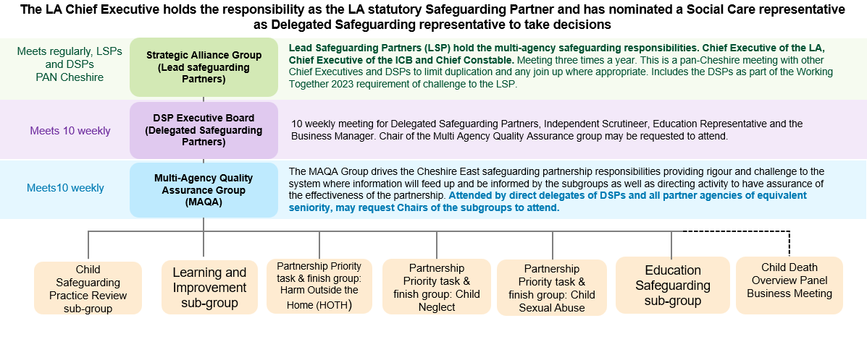
Governance
Across the leadership functions of the Strategic Safeguarding Alliance Meeting and Delegated Safeguarding Partners Meeting, chairing arrangements are on rotation between partners annually.
Relevant agencies are well represented across the partnership subgroups and meetings, with Chairs represented across Health, Police, Local Authority and Education. Drawing on local expertise and understanding to deliver the ambitions of the arrangements.
Meeting Terms of Reference are regularly reviewed to ensure that there is sufficient multiagency representation.

Slide 12
Cheshire East Area Profile
The Cheshire East Safeguarding Children’s Partnership uses intelligence from the Joint Strategic Needs Assessment (JSNA), ward profiles, performance information, quality assurance activity, safeguarding reviews and the voices of children, young people and families to understand local need and inform strategic decision-making.
Cheshire East is the third largest local authority in the North West, with a population of approximately 421,300 residents, including around 83,000 children and young people aged 0–17.
Whilst Cheshire East benefits from generally positive health, education and employment outcomes, the JSNA highlights significant variation between communities, with child poverty, financial hardship, deprivation and rural isolation continuing to impact on the experiences and outcomes of some children and families.
Partnership analysis demonstrates that safeguarding need is not evenly distributed across the borough and that vulnerability is often influenced by a combination of social, economic and environmental factors.
These themes are reflected in local performance information, learning from audits and reviews, practitioner intelligence and the experiences shared by children and families. In response, the Partnership has focused its improvement activity, quality assurance programme and workforce development on strengthening the early identification of neglect, improving responses to harms outside the home, and increasing awareness and professional confidence in responding to child sexual abuse. Through this approach, the Partnership seeks to ensure that local safeguarding arrangements remain responsive to emerging need and continue to improve outcomes for children, young people and families across Cheshire East.

Slide 13
Local Data
Early Help and Safeguarding Contacts
15,225 Contacts
2,347 Referrals
2,765 Early Help / Common / Targeted Assessments
1,107 Section 47 Enquiries
Child Protection
268 Initial Child Protection Conferences
713 Children Subject to Child Protection Plans
Supporting Care Experience and Care Leavers
545 Children Looked After at Year End
1,335 Care Leavers Receiving Leaving Care Support
The partnership continued to prioritise prevention, protection and permanence throughout 2025/26. A total of 2,765 Early Help, Common and Targeted Assessments were completed to provide support to children and families at the earliest opportunity. Children's Social Care received 15,225 contacts, resulting in 2,347 referrals and 1,107 Section 47 enquiries where concerns required further investigation. This led to 268 Initial Child Protection Conferences, ensuring that children at risk of significant harm received coordinated multi-agency assessment and planning.
During the year, 713 children were supported through Child Protection Plans. At year end, 545 children remained in care, reflecting the ongoing commitment to securing safety, stability and positive outcomes for vulnerable children and young people. The partnership also continued to support 1,335 care leavers, helping young people successfully transition into adulthood through access to advice, guidance and practical support.

Slide 14
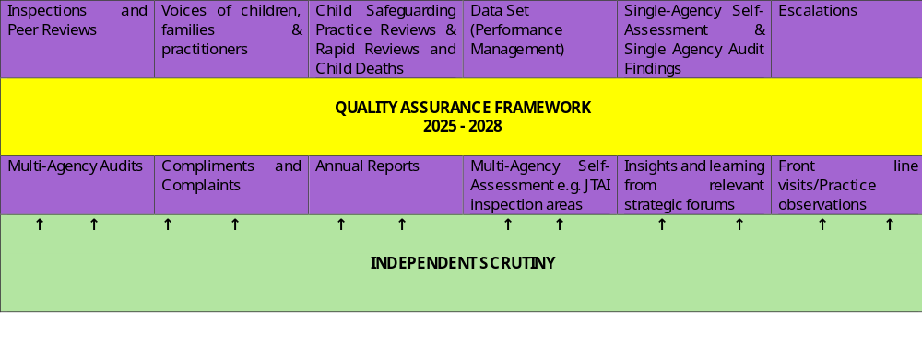
Performance and Quality Assurance Framework 2025- 2028
During the reporting period the partnership introduced a strengthened quality assurance framework which set out expectations for multi-agency partners.
With an emphasis on improving outcomes for Children and Young People (CYP), families, and communities' activity is focused on:
Practice - exploring practice-based issues that affect vulnerable groups.
Organisational context - how organisations approach safeguarding.

Slide 15
Multi-Agency Audits 2025-6
Multi-agency front door safeguarding practice
Areas for development
Consent recording
Opportunities for earlier intervention, particularly in cases with repeat contacts.
Professional curiosity and information gathering
Consistency in capturing the child’s voice and ensuring case continuity.
To address these issues, key actions include
improving guidance,
training, systems for recording consent, and
standardising expectations for management oversight. T
Contact audits of the ‘front door’ take place monthly and scrutinised by a multi-agency panel, which identifies both good practice and areas for improvement. The CESCP ensures that learning from these audits is shared across the partnership to support continuous development.
Good practice
Overall, there is strong practice, characterised by consistent decision-making and clear risk awareness. Practice strengths include effective risk identification and appropriate threshold decisions, timely decision-making with suitable escalation, and strong multi-agency collaboration. In most cases, there is clear management oversight, and a child-centred approach is evident, with the voice of the child captured.

Slide 16
Multi-Agency Audits 2025-6
Police Protection Powers
Areas for development
There are limited opportunities for early intervention, and some families could have benefited from support at an earlier stage.
There is room for improving information sharing and recording
There is an opportunity to strengthen management oversight and escalation
Operational pressures that may affect practice.
Differing multi-agency perspectives impacting on planning.
Key actions include:
strengthening multi-agency oversight and monitoring of
improving recording systems and shared information, and
ensuring management oversight for all case closures and disengagement.
Incidents where police powers of protection (PPP) were deployed are reviewed quarterly by a multi-agency group.
Good Practice
Findings show that PPP is generally used appropriately where there is an immediate risk of significant harm, often in high-risk and complex situations. There are strong examples of professional curiosity, and in some cases, evidence of multi-agency involvement prior to incidents.
Police decision-making reflects a clear safeguarding priority and understanding of legal responsibilities, while effective engagement from health services and CAMHS supports assessment and safety planning.

Slide 17
Multi-Agency Audits 2025/2026
Education as a Protective Factor
Areas for development
Delays in accessing education or reintegration
Variability in practice in the application of assessment tools.
Planning gaps are evident in post-16 provision, clarity of EHCPs, and transition arrangements.
Recording and oversight could be strengthened.
The voice of the child and family is not always fully captured or evidenced in planning or audit processes.
Key actions include;
Reducing time out of education through earlier intervention and stronger access pathways,
Improving consistency in contextual safeguarding approaches and risk assessment tools, and
Strengthening education planning, particularly for EHCPs, transitions, and post-16 pathways.
Enhanced recording of decisions and multi-agency contributions,
Embedding the child and family voice more consistently in planning and audits,
The audit identified how education is a protective factor. There is strong multi-agency working, particularly between education, health, and social care, alongside clear evidence that education can improve outcomes such as attendance, engagement, and stability.
Good Practice
Examples of excellent school safeguarding and pastoral support were noted, including improved attendance and successful post-16 progression. Education is effectively used as a protective factor in many complex cases, supported by strong practice in strategy discussions, conferences, and safeguarding planning.
Overall, education is a key protective factor, with the most positive impact seen where engagement is sustained.

Slide 18
Multi-Agency Audits 2025/2026
Child Safeguarding Practice Review Audit
Areas for development
Limited involvement of extended family networks.
Recording and clarity are sometimes inconsistent.
Information sharing
The child’s voice and co-production are not always clearly evidenced in plans and records.
Key actions include
Strengthening the use of extended family and kinship networks in safeguarding planning.
Improving consistency in recording and the rationale for decision-making.
Undertaking targeted audits
Improving information sharing processes.
Strengthening evidence of the child’s voice and co-produced safety plans.
The findings demonstrated that learning from reviews is being embedded effectively and is contributing to improved frontline safeguarding practice.
Good Practice
Multi-agency strategy discussions and information sharing.
Effective use of education as a protective factor.
High-quality perinatal planning and safeguarding oversight.
Child-centred practice, with evidence of the child’s voice being considered, alongside examples of professional curiosity and constructive challenge.
Positive evidence of multi-agency safety planning leading to tangible improvements.

Slide 19

Education as a Safeguarding Partner
Education providers play a pivotal role in safeguarding and promoting the welfare of children and young people. Schools, colleges, early years settings and other education providers are often the agencies with the greatest day-to-day contact with children, placing them in a unique position to identify emerging concerns, understand children's lived experiences and provide early support. The Cheshire East Safeguarding Children's Partnership is committed to ensuring that education is actively engaged at both strategic and operational levels of the safeguarding arrangements.
The Education Safeguarding Sub-Group provides a dedicated forum for educational leaders and safeguarding professionals to identify emerging risks, share learning, influence partnership priorities and contribute to the development of local safeguarding arrangements.
Through this forum, education providers contribute intelligence, practice insight and the collective voice of the education sector, ensuring that safeguarding arrangements are informed by the experiences of children across educational settings.
Education is recognised as both a protective factor and a vital safeguarding partner in improving outcomes for children and young people.

Slide 20
Section 175 Audits
Embedding partnership priorities remains a key development area
New questions against priorities generated higher levels of “partially effective” responses.
The Partnership recognise that embedding tools into everyday practice takes time, particularly across a large and diverse education sector. In response, the Partnership has aligned its forward planning to strengthen awareness and use of tools linked to neglect and child sexual abuse, including a focus on embedding these tools in practice, particularly in primary schools.
Positive leadership arrangements for safeguarding
All settings confirmed appropriate safeguarding leadership arrangements, including the identification of a Designated Safeguarding Lead (DSL), at least one Deputy DSL, and a Designated Safeguarding Governor. In primary schools, the DSL is most commonly the headteacher, while in secondary schools the DSL is typically a member of the senior leadership team. This reflects compliance with statutory expectations.
Improved quality of audit responses
The level of detail provided by schools and colleges has improved compared to previous years, offering clearer evidence of what is in place and how safeguarding arrangements are developing. This has enhanced the Partnership’s ability to understand strengths and target support effectively.
Key Findings and Themes – Section 175 Audit 2025
Strong engagement and compliance across education settings
All education settings completed the Section 175 audit, achieving a 100% completion rate across schools, colleges, alternative provision, special and independent settings.
Overall safeguarding practice provides reassurance, with clear improvement planning
The audit responses demonstrate that schools and colleges are largely able to evidence effective safeguarding arrangements. Where settings identified themselves as “partially effective” or “ineffective,” the majority provided clear plans for improvement, indicating a strong culture of self‑reflection and improvement rather than simple compliance.

Slide 21
Hearing the voice of the child and their lived experience
We are committed to meaningful engagement with children and young people, ensuring they have a genuine voice in decisions that affect their lives. The Participation and Engagement Strategy using the Lundy Model of Participation, is grounded in Article 12 of the United Nations Convention on the Rights of the Child, which affirms that:
“Children have the right to express their views freely on issues that affect them, and adults should listen and take children seriously.”
Our approach to participation is being embedded through four key principles:
Co-Involvement: Children and young people will be engaged from the outset, with clear communication about changes to services and policy. Their needs and views will be actively sought and valued at every stage of development.
.
Co-Design: We will work collaboratively with children and young people to shape the design of services, individual support, and policy.
Co-Delivery: Services will be planned and delivered in partnership with children and young people.
Co-Evaluation: We will create regular opportunities for feedback and reflection, enabling continuous improvement.
There are spaces, forums and opportunities for us to listen to the voices and lived experiences of our children and young people, these include:
Jigsaw – SEND Youth Forum
Cared for Children and Care Leavers Committee
Children and Families Committee
Care Leaver Monthly Cooking Sessions and Care Leaver Hubs
My VOICE and Junior My VOICE – Children in Care Council
Safeguarding groups in schools (SCiES) and ACT Now Conference
Cheshire East Youth Council

Slide 22
Impact and Outcomes
Participation and Engagement Strategy and has committed to further embed the Lundy Model of Participation
Supporting young people to be involved in shaping the Cheshire and Merseyside Threshold of Need Toolkit
Hosting Voice of the Child Conference, enabling space and opportunity for young people to deliver training
Involved in the North-West Safeguarding Improvement Pilot e.g. train the trainer on the Lundy Model
Involved young people in shaping website content
Since the launch of the guidance on how to capture the voice and lived experiences of children and young people, there have been opportunities for professionals to access training to support improving their practice and confidence when working with children and young people

Slide 23
CESCP Priorities 2025/2026
Cheshire East Safeguarding Children’s Partnership set these four priorities for our activity through 2025/2026.
1. Contextual Safeguarding
2. Child Sexual Abuse
3. Education as a Protective Factor
4. Child Neglect

Slide 24
Harm outside the Home (HOTH)
Cheshire East HOTH strategy aims to strengthen the collective multi-agency response to extra-familial harm and ensure that children are protected within their peer groups, communities, online environments and public spaces. The partnership seeks to:
Prevent children from experiencing harm through earlier identification of risk and vulnerability
Improve recognition of exploitation and extra-familial harm across agencies
Ensure children and families receive effective, coordinated and timely support
Strengthen disruption of harmful individuals, groups and locations
Place children, young people and their lived experience at the centre of safeguarding responses
Deliver a whole-system, multi-agency approach across partners and geographical boundaries
During the reporting period, the partnership has
Launched a Harm Outside the Home (HOTH) Strategy (2026–2029) strengthening consistency in approach and aligning activity across agencies.
The strategy has been informed by audit, scrutiny, practitioner feedback and partnership learning, ensuring it reflects the local Cheshire East context
Strengthened governance and system oversight: governance arrangements are in place, supported through CESCP strategic leadership and multi-agency quality assurance processes. The partnership have improved visibility, challenge and accountability
Improved system insight through audit and scrutiny
Multi-agency audit, independent scrutiny and strategic workshop activity has strengthened understanding of risk, system strengths and areas for development allowing the partnership to identify priority areas for improvement.
What the Data Tells Us Children reported missing from home reduced from 326 in Q1 to 184 in Q4. Repeat missing incidents reduced from 66 to 40 during the year. High-risk Child Criminal Exploitation (CCE) cohorts reduced significantly across both North and South localities. High-risk dual exploitation cases reduced across the reporting period.

Slide 25
Harm outside the Home (HOTH)
Analysis of audit, scrutiny and partnership learning provides a consistent picture of system strengths alongside significant ongoing challenges.
Children experiencing harm outside the home present with multiple, overlapping and cumulative vulnerabilities, including disrupted education, poor mental health, missing episodes, harmful peer associations and exposure to unsafe environments. These vulnerabilities are interconnected and reflect adolescent development within high-risk contexts.
Despite strong professional engagement and high levels of activity, the partnership has identified that this is not yet consistently translating into reduced harm for children.
Multi-agency audit, independent scrutiny and partnership learning highlight key areas for further strengthening:
Activity to impact: Interventions are often sustained and resource-intensive; however, risk can remain high over time, and further work is required to evidence consistent reduction in harm
Multi-agency alignment: Agencies are actively involved, but activity is not always fully coordinated, with opportunities to strengthen shared planning and outcomes
Ownership and accountability: It is not always clear who is the lead professional
Thresholds and pathways: Movement between Child Protection, Child in Need and Early Help does not always clearly reflect risk
Dynamic risk management: Risk assessment supports identification, but consistent use to track, review and reduce risk over time remains variable
Contextual response: Recognition of peer and place-based risk is improving; however, coordinated disruption and place-based responses require further development
Understanding adolescent behaviour: Continued work is needed to embed trauma- and exploitation-informed practice across agencies

Slide 26
Next steps 2026-27
The partnership feel assured that that risk identification is well established, multi-agency engagement is strong, and governance and strategic oversight have strengthened during the reporting period.
However, consistency of coordinated, outcome-focused impact for children is not yet fully embedded across the system. The partnership therefore recognises that further work is required to ensure all children at risk of exploitation receive a consistently effective safeguarding response. This reflects the complexity of Harm Outside the Home and the need to continue strengthening system coordination, accountability and practice consistency.
Priorities for 2026–2027
Embed a single, clearly understood multi-agency contextual safeguarding framework.
Develop a shared multi-agency dataset and analytical profile of harm outside the home.
Clarify roles, responsibilities and ownership of risk
Strengthen multi-agency coordination
Enhance performance management and quality assurance processes.
Ensure learning from audit, scrutiny and reviews is systematically embedded into practice and informs service development
Increase engagement with children, young people and families to ensure safeguarding responses are informed by lived experience
Further develop a whole-system approach by strengthening alignment between children’s services, policing, community safety and partner agencies
Strengthen disruption, prevention and place-based safeguarding responses, with increased focus on peer groups, locations and wider contextual risks

Slide 27
Child Sexual Abuse
Key Achievements 2025/2026
In 2024/25, the NSPCC to undertook a Snapshot Assessment, providing a system‑wide review of Cheshire East’s multi‑agency response to child sexual abuse. The Snapshot combined learning from a strategic multi‑agency session, with survey responses from 33 multiagency professionals. This provided an important baseline.
Child Sexual Abuse Strategy 2025–2028
Improved collection, sharing and use of data, addressing previously identified fragmentation and supporting more effective strategic oversight.
Focus on strengthening practitioner confidence, in relation to identification and response to child sexual abuse and harmful sexual behaviours, through ongoing multi‑agency learning and training activity.
While progress was made during 2025/26, the partnership recognises that not all areas of improvement identified through learning and review have yet been fully addressed. This reflects the scale and ambition of the work required, the complexity of child sexual abuse, and the system‑wide change needed to improve consistency, confidence and outcomes. Learning from the NSPCC Snapshot and ongoing partnership scrutiny has reinforced the need for a phased, longer‑term approach. The Child Sexual Abuse Strategy 2025–2028 provides the framework through which this improvement will continue to be driven and monitored.
2025/26, agencies recorded 1,128 Child Sexual Abuse contacts, demonstrating continued identification of CSA concerns across the partnership. 435 progressed to referral, giving an overall conversion rate of 38.6%. Conversion rates remained relatively stable throughout the year, ranging from 40.0% in Q1 to 38.6% in Q4. This provides assurance that CSA concerns continue to be identified and escalated consistently across the safeguarding system

Slide 28
Next steps 2026-27
Building on learning from 2025/26, the partnership’s focus for 2026/27 will be on delivery, consolidation and evidencing impact, using established frameworks rather than introducing new priorities.
Implementing and embedding delivery of the Child Sexual Abuse Strategy 2025–2028.
Continuing to strengthen practitioner confidence and consistency of practice.
Strengthening the use of multi‑agency audits to test practice, understand children’s lived experience and evidence improvement over time.
Further developing the partnership response to harmful sexual behaviours, prevention and recovery.
Improving the quality and use of data to support partnership oversight, learning and service planning
Maintaining strong governance, scrutiny and learning loops to support continuous improvement.

Slide 29
Education as a Protective Factor
A short video has been recorded to share our practice in Cheshire East in the new DFE Attendance toolkit for Local Authorities. A further focus on this was shared with LA’s nationally as part of a toolkit action learning set.
Vital signs attendance report card under scrutiny in the Improvement Board shares persistent absence concerns for vulnerable children on assessment and plans.
Crewe police seeking community feedback on supporting children to attend school, following an increase anti-social behaviour.
Education data shared and scrutinised in CESCP scorecard
Safeguarding children's partnership training covering education as a protective factor in termly child protection training and with spotlight sessions on attendance, elective home education, tuition and admissions.
Safeguarding children's partnership training covering education as a protective factor in termly child protection training and with spotlight sessions on attendance, elective home education, tuition and admissions.
Ongoing regular Education as a protective factor roadshows (Governors Conference Oct 2025, Healthy Young Minds Conference November 2025)
In 2025/2026, the partnership introduced an Education Safeguarding subgroup. This is chaired by the Local Authority Director of Education and brings together representation across all schools in Cheshire East.
Key achievements include:

Slide 30
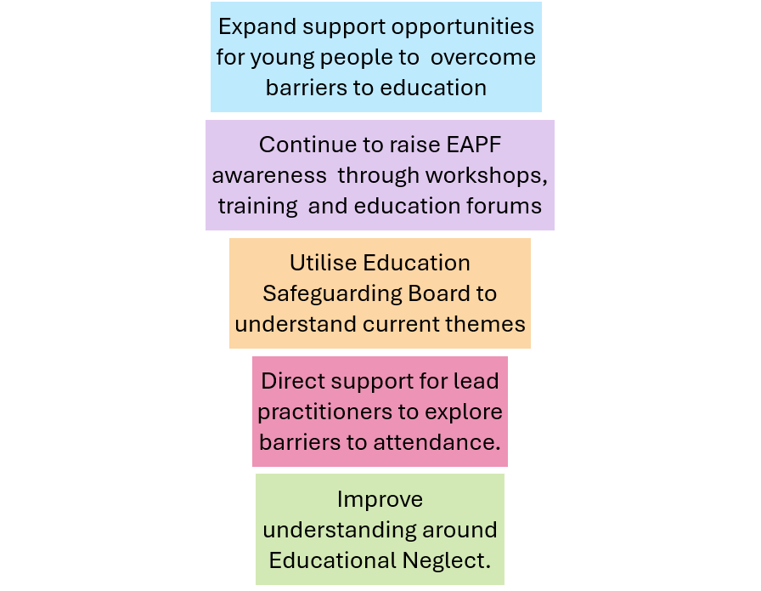
Impact and Outcomes
What is different for our children?
The data provides evidence that Cheshire East has lower than average attendance for Secondary aged children supported with child protection plans. At the time of writing the report there were 0 electively home educated children and 1 Child Missing Education supported by Child Protection plan supported by Child Protection plans
However, at the time of writing there are still have 12 electively home educated children and 12 Child Missing Education supported by Child in Need plans
February 2025: All Children's Services teams access to attendance, Elective Home Education, Children Missing Education and exclusion status, to inform conversations, direct work and plans.
May 2025 – A multi-agency audit found quick re-engagement with school for an EHE child supported with a Child Protection plan; strong multi-agency involvement and current positive school engagement.
January 2026 - Access to support and engagement opportunities for young people with barriers to attendance e.g South Cheshire ABC Boxing Club and Cheshire East Youth Support Service working to prevent young people being excluded from schools
Next steps 2026-27
February 2026 – a multi-agency audit found a child's voice listened to around barriers to attendance to influence their family help assessment.

Slide 31
Child Neglect
Key Achievements
Development of the Child Neglect Strategy (2025–2028)
Progression of a multi-agency neglect toolkit, with development underway and early tools, including the child neglect identification tool, being introduced through training to support consistent assessment and decision-making; full embedding into practice remains ongoing.
Establishment of governance arrangements to support delivery, including oversight through a Neglect Task and Finish Group and alignment with wider partnership quality assurance processes.
Embedding neglect within partnership quality assurance and audit activity, improving oversight of practice and strengthening the partnership’s ability to evidence impact on outcomes for children, although further work is required to demonstrate consistent improvement.
Strengthening practitioner awareness and system understanding, with training and engagement activity contributing to improved recognition of neglect; however, consistent application across agencies continues to develop.
Delivery of a multi-agency training programme, strengthening practitioner understanding and confidence in identifying and responding to neglect.
The partnership aims to:
Ensure a child-centred approach, placing the needs, safety and wellbeing of children at the heart of decision-making
Adopt a family-focused approach, supporting families to provide safe and nurturing environments
Deliver a collaborative multi-agency response, working across partners to achieve the best outcomes
Use evidence-based practice to inform interventions and improve understanding of neglect
Improve early identification and response to neglect, reducing escalation and long-term harm
Ensure services are inclusive and responsive to the diverse needs of children and families

Slide 32
Child Neglect
Variability in identification and response at early intervention
The consistent application of learning across agencies is still developing, with variation in practitioner confidence and decision-making
There is still variation in threshold application
The child’s lived experience is not yet consistently central to assessment and planning,
More work is needed to evidence measurable improvements in outcomes for children
Neglect remains a significant safeguarding concern, with 1,218 neglect contacts recorded across 2025/26
398 contacts progressed to referral, resulting in an overall conversion rate of 32.7%
Key system challenges
Analysis of audit activity, partnership learning and emerging practice feedback indicates that, whilst significant progress has been made in developing a refreshed strategic approach, implementation is at an early stage and not yet consistently embedded across the system.

Slide 33
Next steps
Priorities for 2026/2027
Building on this progress, the focus for 2026–2027 is to embed the strategy into consistent multi-agency practice and demonstrate improved outcomes for children.
Priority areas include:
Launch and embed the Child Neglect Strategy across all partner agencies
Strengthen early identification and intervention by embedding training and the use of the child neglect identification tool in practice
Improve practitioner confidence and consistency
Develop and embed a multi-agency neglect toolkit
Strengthen multi-agency understanding of thresholds and pathways to ensure children receive the right help at the right time
Improve the visibility of the child’s lived experience within assessment, planning and review processes
Enhance quality assurance and performance frameworks to evidence impact and improved outcomes for children
Increase engagement with children, young people and families to ensure services are informed by lived experience
Continue to develop partnership data and intelligence to support strategic oversight and targeted improvement

Slide 34

Child Safeguarding Practice
Reviews (CSPR)
During 2025/26, the Partnership undertook two Rapid Reviews and concluded one Local Child Safeguarding Practice Review (LCSPR) .
The first Rapid Review considered the circumstances of a very young infant who sustained significant physical injuries, the child was not known to Children's Social Care, Police or Education, and no safeguarding concerns had been identified previously.
The review identified significant good practice, particularly within midwifery services, which provided high-quality care and support throughout the antenatal and postnatal period.
Learning was identified in relation to professional curiosity, routine enquiry regarding domestic abuse, consideration of parental history and neurodiversity, and opportunities to strengthen information sharing.
The review concluded that appropriate support had been provided based on the information available at the time.
Local Child Safeguarding Practice Reviews (reviews) are undertaken on ‘serious child safeguarding cases’ to learn lessons and improve the way in which local professionals and organisations work together to safeguard and promote the welfare of children.
The National Child Safeguarding Practice Review Panel has emphasised the responsibility of safeguarding partners to decide upon whether a review is needed or not. The partnership adhere to the Child Safeguarding Practice Review Panel guidance for safeguarding partners (September 2022).
All Local Child Safeguarding Practice Review reports can be found on the partnership’s website: Cheshire East Safeguarding Children’s Partnership

Slide 35
Child Safeguarding Practice Reviews
The second Rapid Review followed the tragic death of a young person through misadventure. The review identified a range of complex and interrelated vulnerabilities, including difficulties in forming and maintaining positive relationships, emerging neurodiverse traits, susceptibility to peer influence, substance misuse, and mental health concerns. These factors were not consistently recognised or addressed through a sufficiently coordinated multi-agency response.
The review identified the need for stronger and information sharing across geographical boundaries.
Collectively, both reviews reinforced the importance of professional curiosity, early identification of vulnerability and risk, effective contextual safeguarding practice, robust information sharing, and coordinated multi-agency planning to protect children and young people from harm.
Child A, who had previously resided in Cheshire East before moving to Wales, tragically died because of maternal filicide during an episode of psychosis.
A key theme was the child’s elective home education status, and information sharing when children move across local authority boundaries. Work has since been undertaken to strengthen processes relating to electively home educated children moving out of area.
During the year, Cheshire East Safeguarding Children's Partnership also completed a review focused on a teenager experiencing exploitation, substance misuse, emotional trauma, and instability within care and placement arrangements.
Despite extensive multi-agency involvement, the absence of a single coordinated plan resulted in fragmented responses and inconsistent risk management. The review reinforced the importance of professional curiosity, recognising and responding to parental insight, and ensuring that behaviours are understood within the context of trauma, exploitation and coercion.

Slide 36
Outcomes and Impacts
The Partnership agreed a programme of activity to ensure learning is embedded into practice. This includes;
strengthening multi-agency planning through the Families First programme via the introduction of a single assessment and plan.
enhancing reflective supervision.
expanding professional curiosity training.
continuing restorative practice training across partner agencies.
Learning will also be incorporated into the Harm Outside the Home Practice Framework alongside consideration of findings from independent scrutiny.
Learning continues to drive measurable improvement across the Partnership. Multi-agency audits tested the impact of learning from previous Rapid Reviews and LCSPRs, including themes relating to child sexual abuse and education as a protective factor.
The audits provided assurance that learning from reviews is influencing frontline practice, with evidence of timely multi-agency risk management, child-centred decision-making, effective safeguarding coordination, strong information sharing, professional curiosity, and engagement from education, health, police and Early Help partners.
Additional quality assurance activity focusing on electively home educated children found consistent evidence of safe and informed decision-making, improved support planning, and effective identification and management of risks including mental health concerns, isolation and curriculum suitability.

Slide 37
Outcomes and Impacts
A revised Bruising in Children who are not Independently Mobile guidance has been issued by the Pan Cheshire areas
The voice of the child has been included within the audit framework and there is evidence of improvement within recent multiagency audits of the child’s voice being captured and responded to.
School processes have been tightened to ensure there are no gaps in information sharing when staff are absent or there is a change of staff.
When the Special Educational Needs and Disabilities (SEND) panel decline an Education and Health Care Plan (EHCP) request for assessment or plan, they now refer into appropriate other services to support the child, recent examples have been the elective home education team, or the medical tuition service who have been able to provide support to the child and their family.
When decommissioning services, the importance of existing relationships with children are considered and responded to. Key workers from a recently decommissioned service have been moved into roles within youth support and exploitation teams to enable them to continue with those relationships.
Midwifery Policy changed by adding a Quality and Governance midwife and Community Team Leader
The Maternity Booking Policy was updated to strengthen engagement with appointments with services out of area.

Slide 38
Child Safeguarding Practice
Review Group
.
CSPR Group
Key Achievements Learning and Improvement
The group was recently introduced to provide expertise and oversight of the review process and outcomes. .
The group holds delegated responsibility on behalf of the Delegated Safeguarding Partners, bringing both strategic and operational perspectives from their respective organisations.
Members champion a culture of continuous improvement by disseminating information, sharing examples of good practice, and highlighting barriers to progress, demonstrating how partnership learning translates into tangible impact.
Contributed to partnership priorities.
Had oversight of Children’s Social Care Improvement journey
Contributed to the development of the partnership training programme.
Informed monthly multiagency briefing sessions
Suppoted the development of the quality assurance framework.
Maintained oversight of recommendations and outcomes from reviews.

Slide 39
Child Death Overview Panel
The Pan Cheshire Child Death Overview Panel (CDOP) continues to play a vital role in understanding identifying opportunities to prevent future deaths through learning, challenge and system improvement.
During 2024/25, the Panel reviewed 70 child deaths across Cheshire East, Cheshire West and Chester, Halton and Warrington, representing an increase in completed reviews from the previous year, whilst also reducing the number of outstanding cases awaiting review.
The work of the Panel provides independent multi-agency scrutiny of child deaths and ensures that learning is shared across the safeguarding system to improve outcomes for children and families.
Analysis of reviews identified that the majority of deaths occurred during infancy, particularly within the neonatal period, with perinatal and neonatal events remaining the most common category of death. The review process highlighted the impact of wider health and social inequalities, with a higher proportion of deaths occurring in more deprived communities.
Modifiable factors were identified in over half of reviewed cases, with key themes including service provision, maternal health, smoking, mental health and late engagement with maternity services. These findings have informed local and regional improvement activity, helping partners focus on areas where intervention may reduce future harm and improve outcomes.
Alongside its review function, the Panel has demonstrated a strong commitment to learning and prevention. More than 700 professionals participated in learning events during the year, covering topics including infant vulnerability, safe sleep, maternal mental health, bereavement support, water safety and road safety.
The publication of briefings, awareness campaigns and learning resources has strengthened professional awareness and supported a culture of continuous improvement across the partnership.

Slide 40
Workforce Development
Training Offer
Key Achievements
Reviewed annually, the training offer is responsive, relevant, and informed by participant feedback and evidence of 'what works’. Training topics and learning themes are informed by quality assurance activity.
Our training offer
‘How to...?’ sessions providing practical guidance
‘Spotlight on...’ sessions create space for relationship building across agencies and sectors
‘CESCP Essential Learning Briefings’ to share key learning from audits and case reviews, promote new services and policy developments, and highlight examples of good practice..
Up to date information is available via our website.
An updated website is in development to improve accessibility, streamline safeguarding information, and provide a central hub of resources.
Developing a clearer understanding of the full range of service offers and practitioner learning provision across agencies, supporting a more coordinated approach to workforce development.
Collaborative work has focused on delivering cost-effective, jointly delivered training and supporting development opportunities .
An increasingly accessible model supports widespread engagement and helps to embed learning across the workforce.
Cancelled training events remain at a minimum
67 events were delivered in 25/26, attracting 1.047 attendees.

Slide 41
Training feedback
“I came to the Neglect training on Monday, and I just wanted to say again how good it was! I must admit I was dreading a full day of in person training, but you kept me engaged throughout and it was one of the best I’ve been on”
Neglect - June 2025
“Ash’s personal experience and the contributing factors that led to his life going a certain way helps to understand the significant ACES and trauma that may cause the children I work with to take the same risks”
Contextual Safeguarding - March 2026
“I have a fuller understanding of processes and terminology used. Understanding the purpose of each type of meeting I am invited to”
Child Protection Processes – November 2025
“Really informative, helped give confidence and reassurance that as a professional and a school, we are equipped to manage staff conduct safeguarding matters effectively. AMM information was helpful as I haven’t been part of or aware of these previously.”
LADO Managing Allegations – November 2025
“Useful training with lots to think about and useful reminders. Hearing from different agencies to support with the trio and learning more about what they offer.”
Trio of Vulnerabilities – September 2025

Slide 42
Practice observations
Between 3 and 7 February 2025, the Partnership undertook 24 practice observations, comprising 11 observations by Safeguarding Children's Partnership representatives and 13 by Children's Services managers.
Observations included child protection conferences, home visits, supervision sessions and legal advice meetings, providing a broad insight into safeguarding practice across the system.
A range of partner agencies participated in the exercise, including health, education, police, housing and local government, ensuring a strong multi-agency perspective on practice strengths and areas for development.
Themes for Learning and Development
Professional Curiosity: Encourage deeper exploration in discussions and reviews.
Legal Advice Meeting Preparation: Develop a checklist to ensure thorough, evidence-based decision-making.
Threshold Understanding: Improve partner agency awareness of child protection thresholds.
Meeting Format: Consider when in-person vs. virtual meetings are most appropriate.
Restorative Practice: Promote respectful, relationship-based approaches and open-ended questioning.

Slide 43
Summary of Learning from Practice observations
While children's views were frequently represented, opportunities remain to strengthen the direct voice and participation of children and young people within planning, review and education processes.
There were also opportunities to further strengthen analytical practice, including the triangulation of information, use of child history and contextual information within decision-making.
Some observations highlighted the need to improve consistency of professional attendance and engagement, while several areas would benefit from clearer guidance, checklists or process refinements to support quality and consistency.
The learning identified will inform ongoing workforce development, quality assurance activity and service improvement, supporting the Partnership's commitment to continuous learning and improved outcomes for children, young people and families.
Observation activity across a range of safeguarding processes provided assurance that practice is generally child-centred, collaborative and relationship-based.
Practitioners demonstrated preparation, professional curiosity, reflective practice and a commitment to working alongside children, families and partner agencies.
Multi-agency forums were well attended and characterised by constructive challenge, shared decision-making and effective information exchange. A consistent strength across observations was the quality of professional relationships.
Supervision sessions demonstrated reflective practice and clear follow-up of actions, whilst meetings and reviews were generally purposeful, respectful and focused on children's needs, safety and future planning.
Observations also highlighted examples of restorative practice, strong family engagement and effective direct work with children.

Slide 44
Partnership Development session December 2025
Cheshire East Safeguarding Children’s Partnership held a development day with senior leaders to consider how multi‑agency working across Cheshire East should evolve to strengthen safeguarding practice and improve outcomes for children and families.
Partners reaffirmed that governance, accountability and cross‑agency collaboration continue to provide a strong foundation, with established structures, effective challenge mechanisms and increasingly confident use of strengths‑based and trauma‑informed approaches.
These strengths are mirrored in Children’s Services quality assurance activity, particularly in relation to relational practice, practitioner persistence and the use of participation forums to shape service design.
Building on this positive foundation, the partnership agreed that a more streamlined and impact‑focused approach is now required to ensure that strategic oversight consistently translates into improved frontline delivery.
Commitment to:
unified multi‑agency scorecard,
clearer escalation pathways and
a more coherent audit and quality assurance framework
This will support change in areas where quality assurance findings have highlighted variability, such as thresholds, information sharing, analytical planning and risk oversight.
Focused on
Strengthening “you said, we did” feedback loops, broadening engagement to include seldom‑heard groups and embedding the child’s lived experience more consistently within multi‑agency audits
Improved information‑sharing standards
Leadership visibility and practitioner‑centred learning
Multi‑agency development days, targeted training aligned to LCSPR themes, improved induction for subgroup members, and clearer expectations around escalation to embed a culture of shared accountability, reflective practice and continuous improvement.

Slide 45
Priorities for the Year Ahead
Safeguarding partners will continue to monitor the impact of Families First reforms, which expect local safeguarding arrangements to support:
Earlier help and intervention to prevent needs escalating.
Integrated Family Help services operating across the continuum of need.
Stronger multi-agency safeguarding and child protection through Multi-Agency Child Protection Teams.
Greater involvement of family networks through Family Group Decision Making.
Consistent and coordinated assessment, planning and decision-making.
Improved education, health and partner agency involvement across safeguarding arrangements.
Relational, restorative and child-centred practice.
Greater focus on impact, outcomes and children's lived experiences.
This activity will be supported by:
A workforce development plan and training offer
Launch of a new CESCP website.
Strengthened co-production of training
Robust mechanisms for evaluation of training
Priorities for 2026 - 2027
Priorities have been shaped through active contributions from key multiagency forums, responding to both emerging themes and ongoing challenges, the Partnership will maintain focused activity in the following areas:
Harm Outside the Home:
Child Sexual Abuse:
Child Neglect:
Alongside these priorities, the Partnership will continue to embed the Participation and Engagement Strategy, working to ensure the voices of children, young people, and families are central to the design, delivery, and evaluation of services.

Slide 46
Table of scrutiny 2025/26
The externally commissioned scrutiny on contextual safeguarding, finalised in March 2026, concluded that, ‘Overall, the scrutiny work highlights a partnership with strong practitioner commitment and emerging strategic clarity, but one that is still developing the system conditions needed for a fully coherent and consistent response to extra-familial harm outside the home. The findings point to an absence of clearly defined leadership oversight in this area, with issues of alignment, structure, reporting, and shared understanding, rather than gaps in effort or intent. Strengthening the connection between strategy, governance and operational practice will position the partnership to deliver a more integrated, data-informed and context-focused approach’.
The Independent Scrutineer would conclude with this statement and that it gets to the heart of the challenges for the partnership.
There is significant safeguarding activity and multi-agency partnership working happening every day, delivered by a highly committed workforce. This is well described in the Annual Report 2025/26.
However, the evidence for the difference made for children and families, particularly where the priorities have been in place for a number of years, should be much stronger.
In the context of a safeguarding system that is on an improvement journey, the Independent Scrutineer would support strategic leaders in ensuring strong governance, accountability, and reporting mechanisms to hold themselves and each other to account.
This needs to be supported by the necessary level of business and project management support, performance and quality assurance oversight and reporting, including intelligence and analytical functions, providing oversight and a robust understanding of practice, for the delivery of effective multi agency safeguarding arrangements.
Area of Scrutiny | Board signs off on the scope | Delivery of the scrutiny work | Report to be with the Board | Completed
Contextual Safeguarding | Virtual sign off December 2024 | January – February 2025 | Initial findings - April 2025 | Final Report to CESCP Exec 19/03/26
Education as a Protective Factor | Virtual sign off February 2025 | April – May 2025 | July 2025 | Not Concluded
Sexual abuse | August 2025 | Sept - Nov 2025 | December 2025 | Not Concluded
Neglect, including the effectiveness of the revised strategy and early prevention multi agency responses | October 2025 | Nov – Dec 2025 | Jan 2026 | Not Concluded

Slide 47
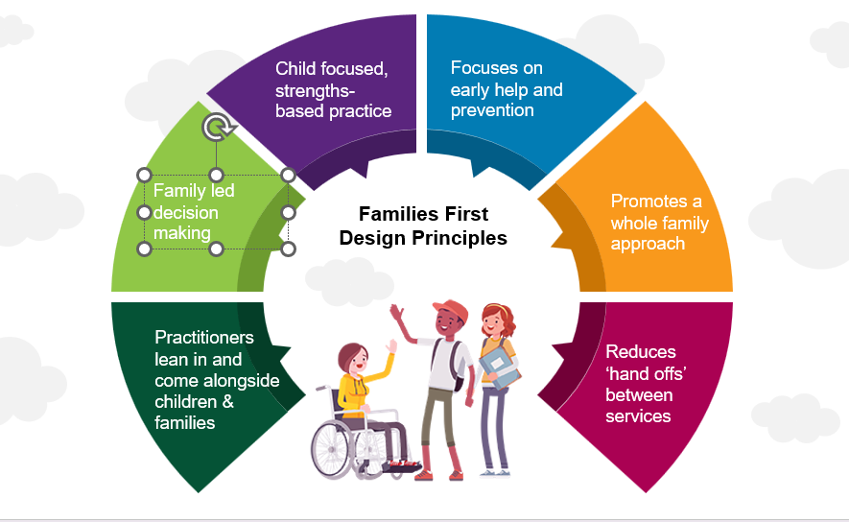
Families First Partnership
As part of the transformation activity a full needs assessment has been undertaken for Cheshire East. This has informed the model of delivery for multiagency support for children and families.
Cheshire East have agreed a four-locality arrangement for Family Help and a centralised Multi-Agency Child Protection Team co-located with the Integrated Front Door.
The partnership vision of the programme strengthens the culture of children best supported within their families and their communities. That all children should enjoy the best education which prepares them to thrive in adulthood. Families and communities are strong and resilient, with the right help, by the right people, at the right time.
These principles are being embedded into relational approach to change, and within our partnership arrangements.

Slide 48
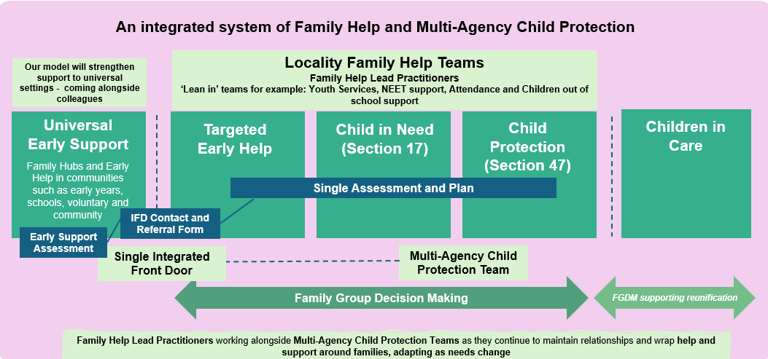
An integrated system
Cheshire East Safeguarding Children's Partnership has provided support and oversight of preparations for the national Families First Programme. Families First represents the most significant reform of children's services and safeguarding arrangements in a generation, with the aim of improving outcomes for children through earlier intervention, integrated family support and stronger multi-agency safeguarding arrangements.
The reform programme seeks to create a more connected system of help, support and protection by strengthening Family Help, embedding Family Group Decision Making, improving multi-agency working and establishing Multi-Agency Child Protection Teams. The programme places children, families and communities at the centre of decision-making, promotes relationship-based practice, and seeks to ensure that children receive the right help, from the right professionals, at the right time.
The Partnership has considered new arrangements relating to Family Help, Multi-Agency Child Protection, family network approaches, education involvement, information sharing, workforce development and local safeguarding arrangements.
The Partnership has sought assurance that reforms are being developed in line with the principles of Working Together 2026, with a continued focus on safeguarding effectiveness, early intervention and improving children's lived experiences.
The Partnership recognises that successful implementation requires strong multi-agency leadership, shared accountability and a commitment to continuous learning.

Slide 49
Key Decisions and Funding
Delegated Safeguarding Partners strategic oversight and decision making during 2025/2026:
Updated the MASA
Approved the Child Neglect strategy and multi agency toolkit.
Received quarterly oversight of the partnership scorecard
Consistent oversight and approval of 1 LCSPR and 2 Rapid Reviews.
Received regularly updates and oversight through the independent scrutiny work for Harm Outside the Home.
Approved the partnership budget for 2026/2027.
Approved the updated Harm outside the Home strategy.
In 2025/26, in line with Working Together (2023), Lead Safeguarding Partners (LSPs) have agreed the level of funding needed to deliver the multi-agency safeguarding arrangements. This includes consideration of business and analytical support, independent scrutiny, infrastructure, and core functions including local children safeguarding practice reviews, multi-agency training and learning events. LSPs have responsibility to ensure that adequate funding is allocated and spent in line with agreed priorities.
Partner Agency | 25/26 agreed contribution
Local Authority | 174,968
Police | 28,660
ICB | 67,547
Schools | 51,500
Other Agencies | 2,596
Total Income | £325,271
Expenditure | 25/26
Staff Salaries | £ 251,515
Training Expenses | £ 379
Transport | £ 618
Supplies & Services | £ 12,434
Professional Fees | £ 37,441
Telephone/ICT | £ 283
Total Expenditure | £ 302,669

Slide 50
Changes to the MASA 2024
Education has moved from an important partner to a core feature of the safeguarding system. Partners recognise education as critical as a protective factor.
As we move forward education becoming embedded throughout governance, assurance, and the transformation within the Families First reforms.
As the programme progresses changes will be aligned to the safeguarding system.
We are building on the foundation of strong engagement and participation toward lived experience being integrated into our quality assurance activities.
New arrangements build on the structures and governance set out to focus on oversight, challenge, learning and impact.
We are continuing to strengthen partnership working with wider relevant agencies through our arrangements.
At the time of writing this report we have continued to develop local arrangements in response to Working Together 2026 and the national Families First reforms.
Whilst the 2024 arrangements established strengthened governance, enhanced education involvement and a revised partnership structure, the updated arrangements reflect a broader whole-system approach focused on Family Help, Multi-Agency Child Protection, Family Group Decision Making, children's lived experience and evidencing impact.
The Partnership has strengthened its approach to assurance, quality improvement and multi-agency safeguarding effectiveness, ensuring that local arrangements continue to evolve in line with national expectations and local need.

Slide 51




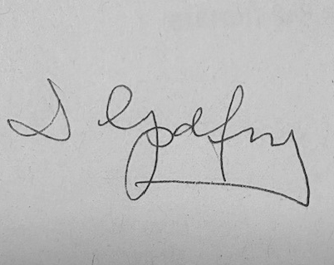

Pledge
Liz Bishop – Chief Executive, statutory Lead Safeguarding Partner for the ICB
Mark Roberts Chief Constable Cheshire Police (LSP)
Helen Charlesworth-May covering Chief Executive Officer
Cheshire East Council
Claire Jesson T/Detective Chief Superintendent Cheshire Police (DSP)
Dawn Godfrey Executive Director of Children’s Services Cheshire East Council (DSP)
Fiona Lemmens
Executive Clinical Director
NHS Cheshire & Merseyside (LSP)

