Slide 1


Cheshire East Safeguarding Children’s Partnership
Multi-Agency Safeguarding Arrangements
July 2026

Slide 2
Contents
The Lead Safeguarding Partners (LSPs)
The Delegated Safeguarding Partners (DSPs)
A shared vision – S.A.F.E.R.
Geographical Context
Multi-Agency Policy and Procedures
Cheshire East Transformation, Families First Programme
Local Assessment Protocol
Family Help Continuum of Need
Governance Structure
Lead Safeguarding Partners Strategic Alliance Group
Chairing Arrangements
DSP Executive Board
Multi Agency Quality Assurance Group (MAQA)
Quality Assurance Framework
Subgroups
Education
Partnership priorities and delivery
Independent Scrutiny
Relevant agencies
How we work with relevant agencies
Information Sharing
Partnership Training and development
Engaging with children, young people and their families
Transitions between children's and adults safeguarding systems.
Arrangements for Local Safeguarding Child Practice Reviews & Notifications to the National Panel
Budget for the partnership and arrangements for funding
Annual Report
Multi-agency escalations and dispute resolution
The Team

Slide 3

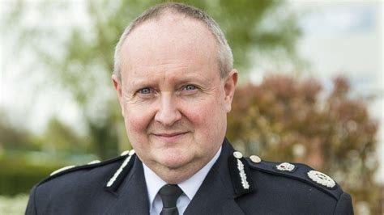


Lead Safeguarding Partners (LSPs)
The three Lead Safeguarding Partners have equal and joint responsibility for local safeguarding arrangements and, together with Relevant Agencies, will work collaboratively through the Cheshire East Children’s Safeguarding Partnership to ensure children are effectively safeguarded.
Mark Roberts,
Chief Constable, Cheshire Police
Helen Charlesworth-May
Interim Chief Executive, Cheshire East Council
Liz Bishop
Chief Executive NHS Cheshire and Merseyside ICB
The Delegated Safeguarding Partners provide senior leadership with evidence-based assurance drawn from:
performance information,
quality assurance activity,
learning from reviews,
risk reporting,
improvement activity,
exception reporting and
the experiences of children and families.
Lead Safeguarding Partners are responsible for agreeing, publishing and monitoring the local safeguarding arrangements and ensuring the partnership is adequately resourced to fulfil its statutory functions
Lead Safeguarding Partners hold one another to account for the effectiveness of the safeguarding system. Where system-level issues are identified, joint actions are agreed and monitored through the partnership assurance cycle to support continuous improvement and improved outcomes for children and families.

Slide 4

Delegated Safeguarding Partners
(DSPs)
Dr Fiona Lemmens, Executive Clinical Director
Deputy DSP
Sarah Martin (Head of Safeguarding (Nursing and Care)
Deputy DSP
Helen Meredith
Director of Nursing & Quality
Dawn Godfrey, Executive Director of Children’s Services, Cheshire East Council
Claire Jesson, T/Detective Chief Superintendent, Head of PVP & Safeguarding Cheshire Constabulary
Lead Safeguarding Partners
Helen Wallace
Chair of The Education Subgroup
Delegated Safeguarding Partners (DSPs) are accountable to their organisation's Lead Safeguarding Partner and have the authority to make decisions and commit their organisation to actions that support the local safeguarding arrangements.
DSPs provide the link between strategic leadership and the day-to-day delivery of safeguarding arrangements. They ensure their organisation contributes to partnership priorities, provides assurance, and responds to learning, risks and areas for improvement.
DSPs use information from performance data, audits, reviews, practitioner feedback, and the experiences of children and families to understand how well safeguarding arrangements are working and where improvements are needed. They are also responsible for ensuring their own organisation meets its safeguarding responsibilities, embeds learning into practice, and contributes positively to multi-agency working, challenge, scrutiny and continuous improvement across the partnership.

Slide 5
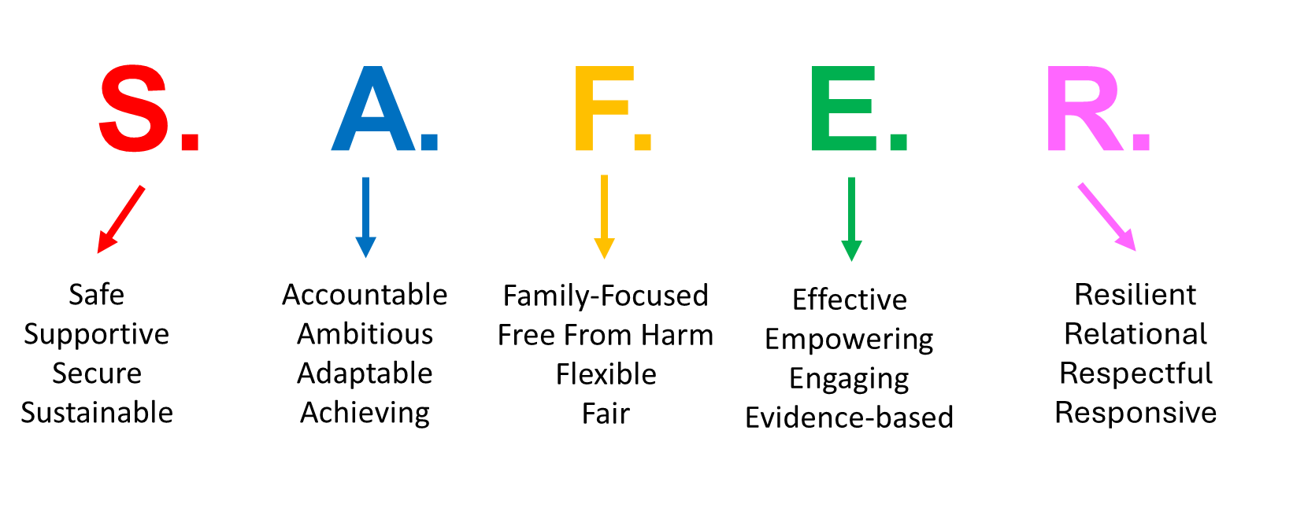
Shared vision and values to improve partnership working
We are committed to working TOGETHER in partnership, and with children, families and our communities to create a S.A.F.E.R place to thrive.
We support child-centred practice which is family-focused, working with the holistic needs of the family. We know that families do best when supported by a family network as a driver of sustained change.
We value and respect children, families, communities and practitioners at every level.
We recognise that a system of high support and high challenge enables consistently strong practice to develop and ensures we remain responsive to emerging and evolving needs.
We are committed to being effective in improving outcomes and delivering meaningful impact for our children.

Slide 6
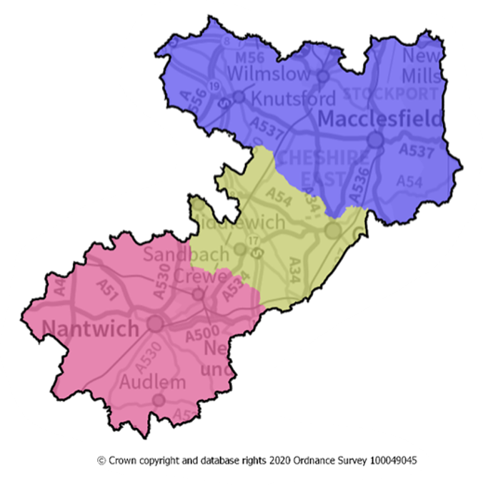
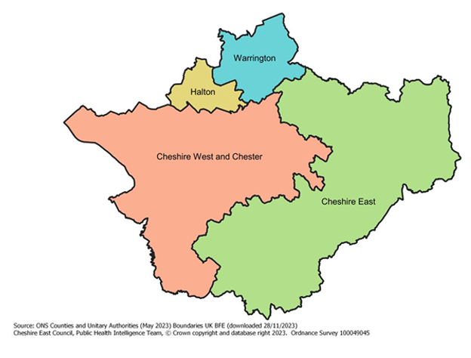
Geographical Context
Cheshire East is a unitary authority with 11 major towns. It is the third largest local authority in the North-West. Our population is around 421,300 residents, including around 83,000 children and young people aged 0-17. Population growth and changing demographics continue to create increased demand for universal, targeted and specialist safeguarding services.
Cheshire East
The borough is predominantly White British (94.4%). Child poverty, financial hardship and deprivation remain significant drivers of vulnerability within Cheshire East. Whilst the borough is comparatively affluent overall, pockets of deprivation are associated with increased safeguarding need, family stress and poorer outcomes for children
Safeguarding need is not distributed evenly across Cheshire East. There is significant variation between communities, requiring targeted responses informed by local need. Neglect remains one of the most prevalent forms of harm experienced by children and continues to be a strategic partnership priority.
Pan Cheshire
We have positive educational, health and employment outcomes. Free School Meal eligibility, youth unemployment and entry into the youth justice system remain below national average. Many Health indicators compare favourably with regional and nationally. We do have a higher-than-average hospital admission rate for younger children.
The partnership continues to identify extra-familial harm, including exploitation, missing episodes and contextual safeguarding concerns, as significant areas of need. Rurality presents both strengths and challenges, including access to services, transport barriers and the potential for hidden vulnerability
Our understanding of local need is informed by JSNA intelligence, ward profiles, safeguarding audits, child safeguarding practice reviews, performance data, practitioner feedback and the voices of children, young people and families.

Slide 7
Multiagency Policies and Procedures
Within Working Together 2026 each partnership is expected to have in place multiagency documents to support a shared understanding of safeguarding and working together
These include
Multi-Agency Safeguarding Arrangements (MASA)
Local Assessment Protocol
Continuum of Need / Threshold Guidance Multi-Agency Information Sharing Guidance
Multi-Agency Professional Challenge and Escalation Procedure
Child Safeguarding Practice Review Procedures
Child Death Review Arrangements (CDOP)
Annual Report
Partnership documents reviewed and updated through the subgroups of the partnership and are published on the Cheshire East Local Safeguarding Partnership Cheshire East Safeguarding Children’s Partnership
Cheshire East works with the Pan Cheshire Policy and Procedures Group to identify and develop regional guidance where appropriate, available via Tri-x here.
To strengthen compliance with our statutory responsibilities the partnership have also developed a:
Quality Assurance Framework
Participation and Engagement Strategy
Multi-Agency Training and Workforce Development Programme
In line with the Families First Partnership Programme expectations the partnership is in the process of developing:
Family Help Policy and Procedures
Multiagency Child Protection Procedures
Multiagency policies and procedures are considered by the local authority Policy, Procedures, and Practice Group to ensure alignment with children service core procedures and Practice Guidance.

Slide 8
Cheshire East Transformation
Families First Programme
The Families First reforms are a significant opportunity to strengthen how agencies work together to help, support and protect children, young people and families. It supports relational, restorative and family-led system that enables children to receive the right help at the right time.
The programme builds on existing strengths, creating a more joined-up system of support that is centred on children’s lived experiences, recognises the expertise and strengths within families, and promotes earlier intervention to prevent needs from escalating. This includes a greater emphasis on multi-agency collaboration, whole-family working, family networks and shared responsibility for improving outcomes.
We have played an active role in the development of Cheshire East's Families First arrangements through engagement with partners, practitioners, children, young people and families. Feedback gathered through workshops, reviews and co-production activity has informed the design and implementation of local arrangements. The Safeguarding Partnership established a Families First Partnership Programme Board to support the implementation of the reforms. The Board has met 6 weekly and includes Delegated Safeguarding Partners.
These multiagency safeguarding arrangements include strategic oversight and assurance of the Families First programme. This includes:
Supporting the development of integrated Family Help
Promoting effective multi-agency working and information sharing.
Ensuring that safeguarding responsibilities remain clearly understood across the continuum of need.
Identifying learning and improvement opportunities through quality assurance activity.
Monitoring the impact of changes on children, young people and families.
Supporting workforce development and shared learning.
We recognise that effective safeguarding is dependent upon strong universal, targeted and specialist services working together around children and families. Families First provides an opportunity to strengthen these relationships and improve the consistency of support across the system.

Slide 9
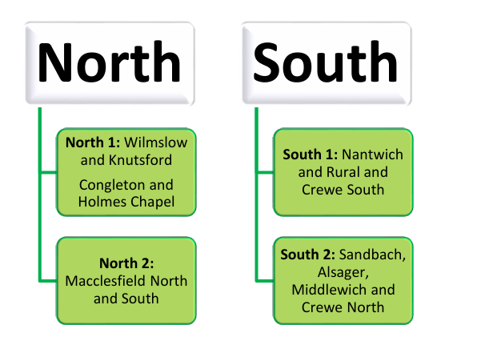
Locality Working
Our locality Family Help Teams will bring together Family Support Workers and Social Workers, supporting children and families across Family Help Alongside our Family Help Teams, our wider children’s services teams will ‘lean in’ to localities wherever possible and where this makes sense to do so.

Slide 10
Local Assessment Protocol
The Local Assessment Protocol sets out how agencies work together to identify, assess and respond to the needs of children, young people and families.
The protocol provides a shared framework for assessment, decision-making, information sharing and multi-agency working, ensuring children receive the right help, support and protection at the right time.
The Local Assessment Protocol supports partners to develop a shared understanding of children’s needs, strengths, risks and protective factors. It is underpinned by a child-centred, family-focused approach which recognises the importance of relationships, family networks, early intervention and coordinated multi-agency support.
The safeguarding partners seek assurance that the Local Assessment Protocol is consistently understood and applied across the partnership through quality assurance activity, multi-agency audits, learning from reviews, performance information and feedback from children, young people, families and practitioners. Learning is used to continuously strengthen assessment practice, decision-making and outcomes for children.
The Local Assessment Protocol supports the delivery of the Cheshire East Families First programme by promoting earlier help, coordinated multi-agency planning, continuity of relationships and a shared understanding of a child’s lived experience. It provides the bridge between the Continuum of Need, local safeguarding arrangements and the operational delivery of Family Help and safeguarding services.

Slide 11
Providing families with the right help at the right time, delivered by the right people
Family Help Continuum of Need:
Universal Services
Family Help
Child Protection
Extra Help
A Child or young person’s health and developmental needs can be met within universal settings and by single agencies; including low level additional needs
Multi-agency approach required using a Family Help assessment and plan led by a lead practitioner supported by, commissioned and family help services
Specialist and high-level interventions involving social workers, multi-agency partitioners and statutory processes to protect the child.
Additional needs may be med by more than one universal service and a co-ordinated approach through partners working jointly with families and with their consent
In Cheshire East we aim to work collaboratively with children and families and to support professionals in understanding the unique situation for each child. All professionals working with children and families will be curious, compassionate, respectful and rigorous in making judgements, while maintaining a clear focus on the safety and protection of children.
Our Extra Help offer will be delivered by partners supported by Partnership Early Help Officers.
Our Family Help offer is centred around the presenting needs of the child and family. Following a referral to the Integrated Front Door we will assess the presenting needs and decide what services and help best meet the needs of the child and family. All families that present with multiple or complex needs will be eligible for our Family Help Offer.

Slide 12
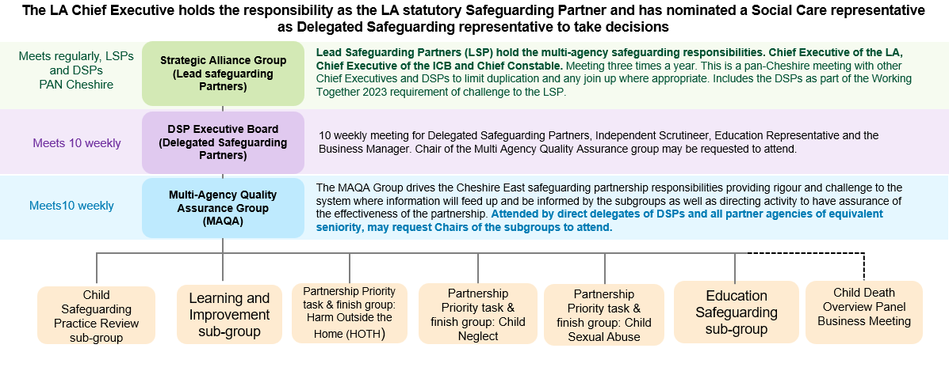
Governance

Slide 13

Lead Safeguarding Partners Strategic Alliance Group
The Cheshire Safeguarding Alliance is a pan-Cheshire strategic leadership group bringing together Lead Safeguarding Partners from Local Authorities, Health, and Police to provide oversight of children's and adults' safeguarding arrangements across Cheshire East, Cheshire West and Chester, Halton, and Warrington.
The Alliance sets strategic direction, monitors performance and risk, promotes consistency and learning, and ensures the voices of children, adults, families, and carers inform safeguarding policy and practice across the region.
Meeting on a pan‑Cheshire basis also supports sub‑regional collaboration aligned to the Cheshire Constabulary footprint and the Integrated Care Boards.
The Strategic Alliance Group is supported by Delegated Safeguarding Partners who:
Support alignment of vision, culture and strategic priorities across pan‑Cheshire safeguarding arrangements
Consider common safeguarding challenges for children, adults at risk and families across the Cheshire footprint
Seek assurance and provide constructive challenge on issues escalated from local safeguarding partnerships
Promote the sharing and dissemination of learning and good practice, including from reviews and inspections
Support alignment and transparency in relation to funding principles and resourcing approaches, where appropriate
The Group reflects on how national and local policy has been embedded into practice, identifies emerging themes and risks, and shares examples of improvement and effective practice across the footprint.

Slide 14
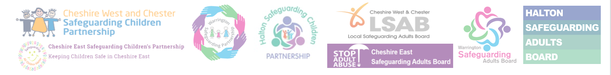
Chairing Arrangements
The Lead Safeguarding Partners Strategic Alliance Group is chaired on an annual rotation between the Lead Safeguarding Partners.
The regular meetings of this group strengthen the approach to safeguarding and enable the Lead Safeguarding Partners to meet their statutory and regulatory obligations to Children and Adults Safeguarding.
The chairing of the DSP Executive Board is undertaken on an annual rotation. This role is current held by Claire Jesson, T/Detective Chief Superintendent.
Working collectively, DSPs provide leadership, challenge and assurance to help ensure safeguarding arrangements improve outcomes and experiences for children, young people and families across Cheshire East.
The safeguarding arrangements are founded on equal and effective partnership between local authority, police, health, education and relevant agencies

Slide 15
The DSP Executive Board
The DSP Executive Board co-ordinates and provides strategic leadership for the safeguarding arrangements. The three Delegated Safeguarding Partners have formally delegated responsibility to act on behalf of their respective agencies: Cheshire Police, NHS Cheshire and Merseyside Integrated Care Board, and Cheshire East Council. Education Representation is an important addition to resilience of the Board in understanding the impact of education as a protective factor and an enabler of strong outcomes for children and young people.
The arrangements were recently updated to reflect greater emphasis in Working Together Statutory Guidance on effective scrutiny and assurance .The Chair of the Multi Agency Quality Assurance group attends to present the work and findings of the Multi‑Agency Quality Assurance Group. The Independent Scrutineer and the Business Manager attend the Board to support effective scrutiny, assurance and delivery of the safeguarding arrangements.
The DSP Executive Board are accountable to the Lead Safeguarding Partners for delivery of the agreed multiagency safeguarding arrangements.
Hold each other and partner agencies to account for effective participation and delivery of safeguarding responsibilities
Provide assurance on the effectiveness and impact of safeguarding practice across the system
Ensure learning from reviews, audits, performance activity and lived experience leads to sustained improvement
Agree strategic priorities, resourcing and funding decisions
Aligns partnership activity to the Children’s Social Care National Framework
Maintain clear escalation routes to the Lead Safeguarding Partners where risks, weaknesses or lack of progress are identified
All activity is underpinned by a strong focus on improving outcomes for children and families.

Slide 16
Multi-Agency Quality Assurance
Group (MAQA)
Purpose
To provide assurance about the effectiveness of the safeguarding arrangements to the Executive.
To oversee the delivery of the Partnership’s Quality Assurance Framework, ensuring a consistent and systematic approach to scrutiny.
To coordinate and scrutinise multi‑agency audits, reviews and thematic activity, including learning from LCSPR, Rapid Reviews, national reviews and inspections.
To Analyse performance intelligence and safeguarding data to assess the effectiveness of local arrangements.
To Ensure the voices of children, families and practitioners inform quality assurance and system learning.
To Identify patterns, trends and systemic issues, escalating concerns where appropriate.
To Hold partners to account for engagement, action and statutory safeguarding responsibilities.
The Quality Assurance Framework (QAF) sets out how the Cheshire East Safeguarding Children’s Partnership evaluates the effectiveness and impact of multi‑agency safeguarding arrangements, ensuring partners have a clear line of sight from frontline practice to strategic leadership.
Function
Brings together a range of evidence including audits, performance data, inspections, reviews and lived experience to assess safeguarding practice.
Enables partners to identify strengths, risks and areas for improvement and respond to emerging issues early.
Supports continuous learning and improvement, ensuring evidence informs decision‑making, priorities and practice.
Provides assurance to Delegated and Lead Safeguarding Partners on the effectiveness of local arrangements.

Slide 17

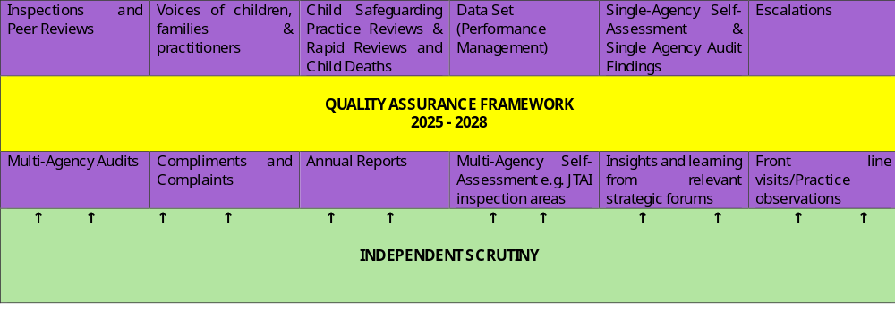
Quality Assurance Framework

Slide 18
Subgroups
Learning and Improvement Group
Aims to strengthen multi‑agency practice and improve outcomes to safeguard and promote the welfare of children.
It supports a learning system, recognising that safeguarding professionals and organisations must reflect on the quality of their services and learn from their own practice and that of others.
Ensures that learning is embedded into practice and informs partnership priorities, improvement activity and workforce development, reporting as required through the partnership’s governance arrangements.
Child Safeguarding Practice Review (CSPR) Sub‑Group
Ensures that learning and recommendations arising from rapid reviews, local child safeguarding practice reviews and other learning reviews are appropriately considered by the safeguarding partners.
Oversees partner responses and ensures that actions are taken to evidence measurable impact and positive change for children and young people in Cheshire East.
Child Death Overview Panel (CDOP)
The Pan‑Cheshire Child Death Overview Panel (CDOP) is a statutory multi‑agency body.
The purpose of CDOP is to:
Improve the experience of bereaved families and professionals following the death of a child.
Ensure that information from child death reviews is systematically captured to enable local learning.
Contribute to national learning through the National Child Mortality Database, informing changes in policy and practice
The Panel includes representatives from health and police agencies, with the four Cheshire local authorities represented by Heads of Service for Safeguarding and Quality Assurance. It meets at least quarterly and is supported by an independently commissioned Chair.
Education Safeguarding Sub‑Group
The Education Safeguarding Sub‑Group provides a forum for educational providers to identify, discuss and respond to safeguarding risks, issues and emerging themes within education settings.
The group supports educational providers to understand and comply with national legislation, policy, guidance and best practice. The group facilitates the sharing of effective safeguarding practice across education settings.
Educational settings participate in considering and providing feedback on the implications of safeguarding decisions, policy changes and local developments within their settings.

Slide 19

Education as a Safeguarding Partner
Education providers play a pivotal role in safeguarding and promoting the welfare of children and young people. Schools, colleges, early years settings and other education providers are often the agencies with the greatest day-to-day contact with children, placing them in a unique position to identify emerging concerns, understand children's lived experiences and provide early support. The Cheshire East Safeguarding Children's Partnership is committed to ensuring that education is actively engaged at both strategic and operational levels of the safeguarding arrangements.
The Education Safeguarding Sub-Group provides a dedicated forum for educational leaders and safeguarding professionals to identify emerging risks, share learning, influence partnership priorities and contribute to the development of local safeguarding arrangements.
Through this forum, education providers contribute intelligence, practice insight and the collective voice of the education sector, ensuring that safeguarding arrangements are informed by the experiences of children across educational settings.
Education is recognised as both a protective factor and a vital safeguarding partner in improving outcomes for children and young people.

Slide 20
Local Priorities and Delivery
Our local profile of need highlights key areas for the partnership to respond to: Child Neglect, Harms Outside the Home and Child Sexual Abuse.
The partnership have established dedicated task and finish groups to deep dive areas of concern, identify and respond to areas of risk with an agreed local approach.
The partnership seeks to respond to safeguarding concerns at the earliest opportunity, supporting families to access help before needs escalate and ensuring children receive protection when risks are identified
Child Neglect remains one of the most common and enduring forms of harm experienced by children and young people. We are focused on strengthening the early identification of neglect, improving professional curiosity, understanding the lived experience of children and ensuring that families receive the right support at the earliest opportunity. The Partnership aims to reduce the impact of neglect and improve outcomes for children and families.
Children and young people can experience significant Harm Outside the Home, including exploitation, serious youth violence, missing episodes and other contextual safeguarding concerns. The Partnership is committed to understanding the environments in which children live, learn and socialise and to working collaboratively to identify, disrupt and reduce risks. This includes strengthening contextual safeguarding approaches and supporting children and families affected by extra-familial harm.
The Partnership recognises the significant and often hidden impact of Child Sexual Abuse. Children may experience abuse within families, trusted relationships, institutions or online environments. The Partnership is committed to improving awareness, identification, professional confidence and multi-agency responses to child sexual abuse, ensuring that children are listened to, protected and supported to recover from harm.

Slide 21
Independent Scrutiny
The Partnership recently reviewed its independent scrutiny arrangements to ensure that skills and capabilities are aligned to the profile of local need and the partnership priorities.
The purpose of scrutiny is to provide independent and effective challenge, support and assurance. An The Independent Scrutineer has been commissioned and attends the Delegated Safeguarding Partners’ Executive Board and, alongside the Delegated Safeguarding Partners. Assurance is received through subgroup chair reports, performance information, audit activity and learning from reviews.
In Cheshire East, the Independent Scrutineer also receives referrals for consideration of serious incident notifications. This ensures independent oversight is embedded within key decision-making processes and supports objective challenge, system learning and continuous improvement.
The approach to scrutiny is proportionate, evidence-informed and improvement-focused, balancing support and challenge to strengthen assurance and improve outcomes for children and families.
Where the need for additional scrutiny is required, the partnership have commissioned specialist scrutiny to undertake dedicated work.
Independent scrutiny evaluates the effectiveness of safeguarding arrangements and provides constructive challenge to safeguarding partners regarding impact, learning and improvement

Slide 22
Relevant Agencies
East Cheshire NHS Foundation Trust
Mid Cheshire NHS Foundation Trust
Wirral Community NHS Trust
Cheshire Fire and Rescue Service
Styal Prison
CAFCASS
Education providers (schools, colleges and early years settings)
Voluntary, community and faith sector organisations
British Transport Police
Adoption Counts
Children’s Centres
Cheshire and Wirral Partnership NHS Foundation Trust
The strength of local partnership working is predicated on working collaboratively with organisations and agencies whose involvement they consider is required to safeguard and promote the welfare of children in the local area.
These organisations and agencies are referred to as relevant agencies. When identified by the safeguarding partners, relevant agencies are expected to act in accordance with the local safeguarding arrangements by fully engaging with the Cheshire East Safeguarding Children’s Partnership’s functions as set out in this document. Regulation 18
Relevant agencies assist the safeguarding partners to discharge their statutory responsibilities, including in relation to local and national child safeguarding practice reviews.
Relevant Agencies have a statutory duty to act in accordance with the safeguarding arrangements as published by the Lead Safeguarding Partners are expected to have robust safeguarding policies and procedures in place that are appropriate to their organisational context.
Relevant agencies may be asked to participate in Section 11 and Section 175 audits to assess compliance with statutory duties under the Children’s Act 1989. Relevant agencies are also expected to participate fully in multi‑agency audits, reviews and assurance activity where required.

Slide 23
How we work with relevant agencies
The safeguarding partners recognise that effective safeguarding can only be achieved through strong collaboration with relevant agencies.
Relevant agencies are engaged through partnership governance arrangements, quality assurance activity, audits, training, reviews, consultations and task and finish groups. These arrangements ensure that local intelligence, emerging risks, practice experience and the voices of partner organisations inform the development, delivery and continuous improvement of safeguarding arrangements.
Relevant agencies contribute to the identification of local priorities, the evaluation of safeguarding practice and learning from reviews, audits and inspections.
Safeguarding partners seek assurance that relevant agencies understand and discharge their safeguarding responsibilities effectively through section 11 and section 175 audits.
The partnership maintains regular communication with relevant agencies through its newsletter and website and provides opportunities for consultation on partnership working.
In Cheshire East, engagement is supported through the Multi-Agency Quality Assurance Group, Education Safeguarding Sub-Group, Learning and Improvement Group, Child Safeguarding Practice Review Group, multi-agency training programme, consultation activity and partnership events. These forums provide opportunities for relevant agencies to influence decision-making, contribute to safeguarding priorities and shape the development of local safeguarding arrangements.

Slide 24
Information Sharing
Where an organisation is identified by the Lead Safeguarding Partners as a relevant agency, it is expected to work collaboratively with safeguarding partners and other relevant agencies to safeguard and promote the welfare of children.
In line with Working Together to Safeguard Children 2026 and the Information Sharing Duty established through the Children Act 2004, safeguarding partners have a joint responsibility to maintain effective information-sharing arrangements that support timely decision-making, coordinated responses and a shared understanding of need, risk and vulnerability.
Effective information sharing is essential to safeguarding and promoting children's welfare. Information should be shared proactively to support prevention.
Relevant information may relate to a child, their parents, carers, family members, peers or other individuals connected to the child and should not be withheld solely because statutory thresholds have not been met.
Where the Information Sharing Duty applies, relevant agencies must share information where it may assist another organisation to assess need, identify risk, make decisions, provide support or take action to safeguard and promote a child's welfare, unless sharing would be more detrimental to the child than not sharing.
Information sharing must be lawful, necessary, proportionate and secure. Data protection legislation provides a framework for sharing information and should not be viewed as a barrier to safeguarding activity.
Pan Cheshire Multiagency Information Sharing Guidance is available here

Slide 25
Training and Development
‘Spotlight on…’ sessions highlight a service, team or individual, offering opportunities to build relationships, improve understanding of roles and responsibilities, and strengthen lines of communication across agencies.
‘How to…’ forums provide practical guidance to support workflows and procedural understanding, encouraging shared and joined‑up approaches to working with children and families.
‘Essential Learning’ a partnership learning platform to disseminate key findings and recommendations from local reviews, audits and learning activity. This supports timely reflection, operational awareness and mindful professional practice
There is a clear expectation that professionals actively contribute to the delivery of the multi‑agency training programme, to share expertise and learning from practice across different services and organisations. This shared approach supports consistent practice, strengthens the learning culture, and improves outcomes for children and families.
Multiagency training is available to all relevant agencies via the partnership website; Cheshire East Safeguarding Children’s Partnership. The partnership have dedicated resource to deliver training and development which includes core safeguarding topics and specialist training.
Programme content is regularly reviewed and updated, informed by service consultations, practitioner feedback, ongoing audits, and learning from local and national practice reviews.
In line with Working Together to Safeguard Children 2026, the multi‑agency training programme is strategically aligned to partnership priorities, emerging risk and system learning, ensuring workforce development supports improved outcomes for children and families.
These core and priority‑led subjects are supplemented by a wide range of relevant and responsive learning activity, delivered in a variety of formats to ensure accessibility and reach across the partnership. To support ease of access, calendar invitations are distributed monthly, enabling practitioners to join short, focused lunchtime sessions.

Slide 26
Engaging with children, young people and their families
The activity of the partnership will reflect the outcomes of the Children and Young People’s Plan to ensure we are working in collaboration with key stakeholders.
We will ensure that children, young people and their families are provided with opportunities to feedback and share their lived experiences. We will use this information to help shape decision making and co-produce local services where possible.
Since the launch of the How we capture the voice of children and young people and their lived experience, there have been opportunities for professionals to access training to support improving their practice and confidence when working with children and young people. Although services across the partnership work differently, there is a shared approach to capturing the voice and lived experiences of our children and young people.
The partnership recognises the role of family and community networks in strengthening resilience and supporting sustainable change for children and families.
The Cheshire East Safeguarding Children’s Partnership has mechanisms for engaging with children and young people. There are spaces, forums and opportunities for us to listen to the voices and lived experiences of our children and young people, these include:
Cheshire East Youth Council
Cared for Children and Care Leavers Committee
Children and Families Committee
Corporate Parenting Executive Board
SEND Partnership Board
Education and Safeguarding Board
Families First Partnership
Safeguarding groups in schools (SCiES) and ACT Now Conference
My VOICE and Junior My VOICE – Children in Care Council
Care Leaver Monthly Cooking Sessions and Care Leaver Hubs
Care Leaver Ambassadors
Jigsaw – SEND Youth Forum

Slide 27
Participation and Engagement
Strategy
Lundy Model of Participation.
The partnership is adopting the Lundy Model to strengthen how
we capture and include the voice of children and young people.
The Quality Assurance Framework is designed to ensure that
that the voice of the child and their lived experiences is recorded
in a way that tells us exactly what life is like for them. Learning is
captured Learning and Improvement Group in a loop of quality
assurance and practice improvement.
Multi Agency audits are structured to ensure we include the
voices of children and use the learning to influence and shape
practice through training and development opportunities which
have an impact on the service that children and young people
receive.
Key successes in the past 12 months:
Launch of participation and engagement strategy
Supporting young people to be involved in shaping the Cheshire and Merseyside Threshold of Need Toolkit
Hosting Voice of the Child Conference, enabling space and opportunity for young people to deliver training
Involved in the NW Safeguarding Improvement Pilot e.g. train the trainer on the Lundy Model
Involved young people in shaping website content

Slide 28
Transitions Between Children’s and
Adult’s Safeguarding Systems
Safeguarding risks do not end at age 18, and that transition points between children’s and adults’ services present a period of increased vulnerability, particularly for young people aged 16–18 who experience multiple and complex risks.
Young people affected by exploitation, contextual harm, mental ill‑health, substance misuse, homelessness or involvement with the criminal justice system often require joined‑up safeguarding responses that span children’s and adults’ systems. Learning from reviews, audits and quality assurance activity is used to inform how transition risks are identified, planned for and managed, including where adult safeguarding frameworks become relevant before or shortly after a young person turns 18.
The partnership works closely with the Safeguarding Adults Board and the Integrated Care Board to support continuity of safeguarding oversight at transition points. This includes shared system leadership and information‑sharing where young people approach adulthood and safeguarding concerns may meet thresholds for adult safeguarding, mental health or wider public protection responses.
Transition‑related safeguarding risks are supported through the arrangements for Harms outside of the Home. The partnership remains committed to strengthening alignment across children’s and adults’ safeguarding arrangements to reduce transition‑related risk and improve outcomes for young people as they move into adulthood.
More information can be found here Transitional Safeguarding

Slide 29
Local Safeguarding Child Practice Reviews & Notifications
LCSPRs are undertaken in respect of serious child safeguarding cases to identify learning and improve how local organisations and professionals work together to safeguard and promote the welfare of children. The safeguarding partners are responsible for deciding whether a local review is required and for ensuring that learning leads to measurable improvement and impact for children and families.
The partnership adheres to the Child Safeguarding Practice Review Panel guidance for safeguarding partners (September 2022) and ensures that reviews are proportionate, learning‑focused and completed as promptly as possible.
Statutory notifications are made via the national notification system, in line with government guidance:
All published Local Child Safeguarding Practice Review reports are available on the partnership’s website (www.cescp.org.uk). In line with the partnership’s publication and information‑retention policy, reports are published for a period of three years following completion.
The Child Safeguarding Practice Review (CSPR) Group has oversight of all serious child safeguarding cases, including the management of statutory notifications, decisions regarding the commissioning of reviews, and oversight of related recommendations and action plans. The Group also considers examples of effective practice identified through reviews and learning activity.
Monitoring the progress, quality and timeliness of reviews
Overseeing the development and delivery of improvement plans arising from reviews
Ensuring actions are completed within agreed timescales and supported by appropriate evidence
Ensuring key learning and examples of good practice are shared and embedded across the partnership

Slide 30
Budget for the partnership and arrangements for funding
The current income for the safeguarding arrangements is made up of contributions from the Local Authority (including school contributions), health partners, Cheshire Police and Styal Prison.
Arrangements are in place through the Strategic Alliance Group and includes consideration of business and analytical support, independent scrutiny, partnership infrastructure, and the delivery of core functions such as Local Child Safeguarding Practice Reviews, multi‑agency training and partnership learning activity.
Arrangements are compliant with Working Together to Safeguard Children 2026. Funding contributions from the statutory safeguarding partners are expected to be equitable and jointly agreed.
Funding requirements and sufficiency are reviewed on an ongoing basis, and details of partnership funding and expenditure are set out in the published annual report to support transparency and assurance.
The Delegated Safeguarding Partners have agreed an annual 5% uplift to partnership funding.

Slide 31
Annual Report
The partnership annual report setting out the activity undertaken over a 12‑month period is published on the Cheshire East Local Safeguarding Children Partnership Cheshire East Safeguarding Children’s Partnership
In line with Working Together to Safeguard Children 2026 and the National Child Safeguarding Practice Review Panel Guidance, our reports focus on multi‑agency priorities, learning, impact, evidence and improvement, providing transparency about the effectiveness of local safeguarding arrangements.
The annual report provides a clear analysis of how well local safeguarding arrangements are working, including progress against the partnership’s areas of focus and the impact of partnership activity on the lives and experiences of children, young people, families and communities.
In accordance with Working Together to Safeguard Children 2026, the annual report also includes:
Evidence of improvement, learning and impact
Analysis of disproportionality and access to services
Evidence of education sector engagement within safeguarding arrangements
A value‑for‑money assessment, including a breakdown of financial contributions from partners
A review of restraint practices in secure settings, where applicable
The report includes:
Details of Child Safeguarding Practice Reviews undertaken and associated learning
Findings from multi‑agency audits and thematic reviews
Evidence of how learning has been embedded into front‑line practice and service improvement

Slide 32
Multi-agency escalations and dispute resolution
Differences of opinion and professional debate are a normal and valuable part of multi‑agency working and support appropriate, respectful challenge to improve outcomes for children and their families.
Effective safeguarding relies on strong relationships alongside robust challenge, professional curiosity and timely escalation. While multi‑agency relationships across the partnership are generally constructive, learning from Rapid Reviews, Local Child Safeguarding Practice Reviews and quality assurance activity has highlighted that challenge and escalation are not always applied consistently in practice.
The partnership endorses the Pan Cheshire Procedure for Multi-Agency Professional Challenge available on the partnership website.
Escalations to the partnership are reviewed and themes are overseen by the Multiagency Quality Assurance Group which provides assurance to the safeguarding partners.
Unresolved professional challenge may be escalated through organisational safeguarding leads, the Pan Cheshire escalation procedure and, where appropriate, to the safeguarding partnership

Slide 33

The Team
Head of Service; Heather Baron
Business Manager; Jen Atkinson
Quality Assurance Officer; Alistair Jordan
Business Support Officer x2
Email; CESCP@cheshireeast.gov.uk
Website; Cheshire East Safeguarding Children’s Partnership

